Slide 1
statistical Analysis of house prices in ames, iowa
By: Kandice Gunawan

Slide 2
Introduction
Research question:
What factors drive houses prices?
Goal:
To provide the bank with a better understanding on how it should allocate money for investment in mortgage-backed securities.
Notes:
-In this presentation, I analyzed the residential house prices in Ames, Iowa
-I looked into several research questions and came up with several hypotheses focusing on the factors that would drive house prices, with the end goal to provide the bank with a better understanding on how it should allocate money for investment in mortgage-backed securities.
-These factors include amenities provided in the house, overall sale condition of the house and sale type of the house, since I believe these are the most important factors for a prospective investor.
– I then created a model to provide the bank to use in order to make better business decisions.

Slide 3
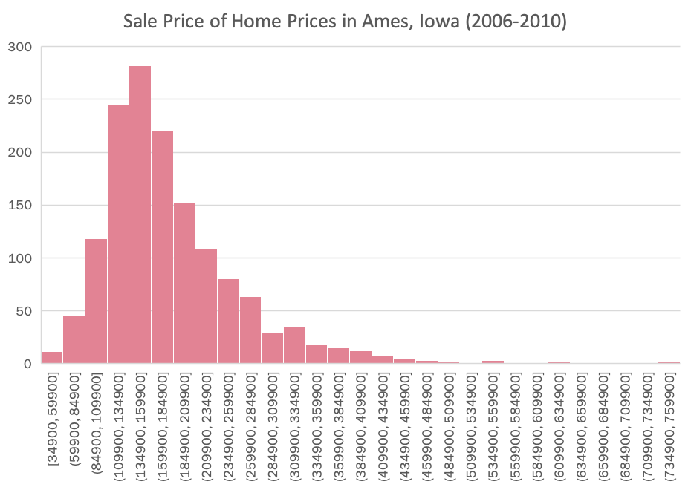
Data
Collection of the final prices of residential homes in Ames, Iowa from 2006 to 2010.
1460 observations
Descriptive Statistics
Mean | 180921.1959
Standard Error | 2079.105324
Median | 163000
Mode | 140000
Standard Deviation | 79442.50288
Sample Variance | 6311111264
Kurtosis | 6.53628186
Skewness | 1.88287576
Range | 720100
Minimum | 34900
Maximum | 755000
Sum | 264144946
Count | 1460
Notes:
-The raw data is collection of the final prices of residential homes in Ames, Iowa from the period 2006 to 2010.
-I ran descriptive statistics on the data to ensure that is it suitable for further analysis.
-The sale prices of the houses is positively distributed with skewness of 1.88, and is a continuous variable.
(Bc it can occupy any value over a continuous range. The data is not restricted to defined separate values)
(In positive skewness the mean and median will be greater than the mode. This is similar to this dataset. So, in Layman's terms, more houses were sold by less than the average price.)

Slide 4
Methods
Data extraction
Statistical analysis (A/B test using PivotTable filtering)
Hypotheses testing (independent sample z-test and t-tests)
Data visualizations (bar chart)
Building an Excel model
Notes:
-These are the steps I took to test the hypotheses.
-The first step I did was from the raw data, I extracted the relevant variables for each hypothesis and created a summary data table on Excel.
-I ran an A/B test and split the data using Excel’s PivotTable filtering with the dependent variable being the proportion of normal sales for H1 and the mean of house prices for the other hypotheses.
-I used the Statistical Analysis ToolPak feature in Ecxel to do the two-sample t-tests to conduct independent sample z-test (H1), independent sample t-tests (other hypotheses). and incorporated my own calculations to obtain the standard error, confidence intervals
-Created data visualizations, bar chart
-Built a model to ensure I can analyze the results to provide the bank with insights and recommendations and stay in line with the main goal.

Slide 5
Results of H₁ (Overall Condition of the House)
H₁: p1 - p2 = 0
H_{1A}: p1 - p2 ≠ 0
Reject H₁ at p=9.14E-09.
There is a significant difference in proportion of normal sales between houses with an overall condition below good quality and houses with an overall condition of good quality of better.
Two Sample z-Test Results
 | below good condition | good condition or above
Proportion of normal sales | 0.79672696 | 0.913043478
Standard deviation | 0.000346627 | 0.016295257
Observations | 1161 | 299
Standard error of proportion | 0.011810779 | 0.016295257
c.i. upper | 0.023163504 | 0.03195854
c.i. lower | 0.023163504 | 0.03195854
Notes:
-A/B testing in overall condition of the house: Houses with scores 7/10 and above are considered good quality or better. Houses with scores below 7/10 are considered below good quality.
-Proportion of normal sales. In the house sales, there are normal sales, abnormal sales (short sales, foreclosures), trade, and family.
-Normal sales = least risky, least problems – correspond to a successful sale.

Slide 6
Results of H₂ (Sale type)
H₂: μ1 - μ2 = 0
H_{2A}: μ1 - μ2 ≠ 0
Fail to reject H₂ at p = 0.75
There is no statistical difference in means of sale prices of houses that were sold as a contract sale and those that were sold as a warranty deed.
Two Sample t-Test Results
 | contract sale | warranty deed
Mean | 167079.9048 | 173518.904
Variance | 8409509640 | 5065483986
Observations | 21 | 1271
Standard error | 20011.3178 | 1996.354661
c.i. upper | 41742.87746 | 4164.322851
c.i. lower | 41742.87746 | 4164.322851
Notes:
-Low quality finished area – located on all floors and is measured in sq ft, they indicate houses that are of lower quality
-These are the results from the second hypothesis in which (H2)
-We reject H2 at the .216 level
-We can conclude with 95% confidence level that there is no statistical difference between the two samples.
–This bar chart provides another visualization.
-From left to right..
-Since there is a total overlap between the bands, it means that we can be 95% certain, statistically speaking that there is no a significant difference in house prices in houses without and with a fireplace.
-This supports our finding of our t-test that there is no significant difference in means.

Slide 7
Results of H₃ (Presence of Fireplace)
H₃: μ1 - μ2 = 0
H_{3A}: μ1 - μ2 ≠ 0
Reject H₃ at p = 4.63E⁻⁸⁴
There is a statistical difference between the means of sales price of houses without a fireplace and the houses with a fireplace.
Two sample t-Test Results
 | w/o fireplace | w/ fireplace
Mean | 141331.4826 | 216397.6922
Variance | 6837086055 | 5888497938
Observations | 690 | 770
Standard error | 3147.827881 | 2765.393267
c.i. upper | 6176.007338 | 5425.674386
c.i. lower | 6176.007338 | 5425.674386
Notes:
-These are the t-test results from the first hypothesis in which (H1)
-We reject H1 at p = 4.63E-84.
-With 95% confidence level, we can conclude that there is a statistical difference…
–In order to visualize the results of this t-test, I plotted two samples with two distinct confidence interval “error bars”.
-From left to right, the bars represent the mean of sale prices of houses without a fireplace and the mean sale prices of houses with a fireplace.
-The bands around those values represent what we expect with 95% confidence would be the mean of the house prices. Since there is no overlap between the band, it means that we can be 95% certain, statistically speaking that there is a significant difference in house prices in houses without and with a fireplace.
-This supports our finding of our t-test that there is a significant difference in means.

Slide 8
Results of H₄ (Presence of Pool)
H₄: μ1 - μ2 = 0
H_{4A}: μ1 - μ2 ≠ 0
Fail to reject H₄ at p =0.216
There is no statistical difference between the means of sales price of houses without a pool and houses with a pool.
Two Sample t-Test Results
 | w/o pool | w pool
Mean | 180404.6635 | 288138.5714
Variance | 6110372631 | 42465607748
Observations | 1453 | 7
Standard error | 2050.69485 | 77887.83854
c.i. upper | 5017.869531 | 190584.6752
c.i. lower | 5017.869531 | 190584.6752
Notes:
-These are the results from the second hypothesis in which (H2)
-We reject H2 at the .216 level
-We can conclude with 95% confidence level that there is no statistical difference between the two samples.
–This bar chart provides another visualization.
-From left to right..
-Since there is a total overlap between the bands, it means that we can be 95% certain, statistically speaking that there is no a significant difference in house prices in houses without and with a fireplace.
-This supports our finding of our t-test that there is no significant difference in means.

Slide 9
Results of H₅ (Year built)
H₅: μ1 - μ2 = 0
H_{5A}: μ1 - μ2 ≠ 0
Reject H₅ at p = 5.88E-98 level.
There is a significant difference between the average sale prices of houses that were built before 1980 and the houses built after 1980.
Two Sample t-Test Results
 | Before before 1980 | Built after 1980
Mean | 142987.9281 | 233482.3252
Variance | 2296635503 | 7122243189
Observations | 848 | 612
Standard error | 1645.690306 | 3411.400338
c.i. upper | 3229.866465 | 6695.286172
c.i. lower | 3229.866465 | 6695.286172
Notes:
Houses were built between 1972 and 2010. statistically speaking

Slide 10
Discussion & Recommendations
What factors significantly affect house prices?
Presence of a fireplace
Year built
What significantly affects proportion of a normal sale?
Overall condition of the house
What factors do not significantly affect house prices?
Sale type
Presence of a pool
How does this impact investment decisions?
Invest in houses with higher sale prices
Invest in houses that are of good quality or better and with normal sales
Potential areas of exploration?
Other attributes
Credit score, interest rate, economic growth
Compare to bigger dataset
Notes:
-After the in-depth statistical analysis, we can conclude that, statistically speaking, the factors that affect house prices are the presence of a fireplace and the year built.
-We can also conclude that the presence of a pool or the sale type of the house does not have a significant impact on house prices.
So what does this mean as a prospective investor such as yourself?
-When investing in mortgage-backed securities, we want to prioritize transactions that is most profitable that have a positive return and that is of least risk because we want a steady return.
-My first recommendation for the bank would be to invest in houses with higher sale prices. First focusing on the amenities and properties of the houses that would uphold the house value, this would mean to prioritize investing houses with a fireplace and those built after 1980. We can neglect houses with a pool and it should not play a huge factor in the decision making process.
My second recommendation would be to invest in houses that are of good quality or better and those with normal sales. Statistically speaking, we found from our results that houses of an overall condition of good quality or better have a higher proportion of normal sales. As an investor, we typically want to avoid abnormal sales, short sales, family sale, or foreclosures etc since they are riskier and promises less return of investment. Houses of good quality will likely to be more popular, easier to sell, and a steady return of investment.
Area of explorations:
-79 variables.
-Houses of higher overall condition an higher sale prices would usually attract buyers with a better credit score. Since this is a factor that is not included in our data, it could be a possible area of exploration for further analysis since a better credit score, would make the invest less risky since the buyer would have a higher chance of making their month to month mortgage payments which mean positive ROI for bank
-Compare results to a bigger dataset (=, either compare with housing data from other states, or find the trend in house prices over year)

Slide 11
Thank you!
Any questions?

